Slide 1
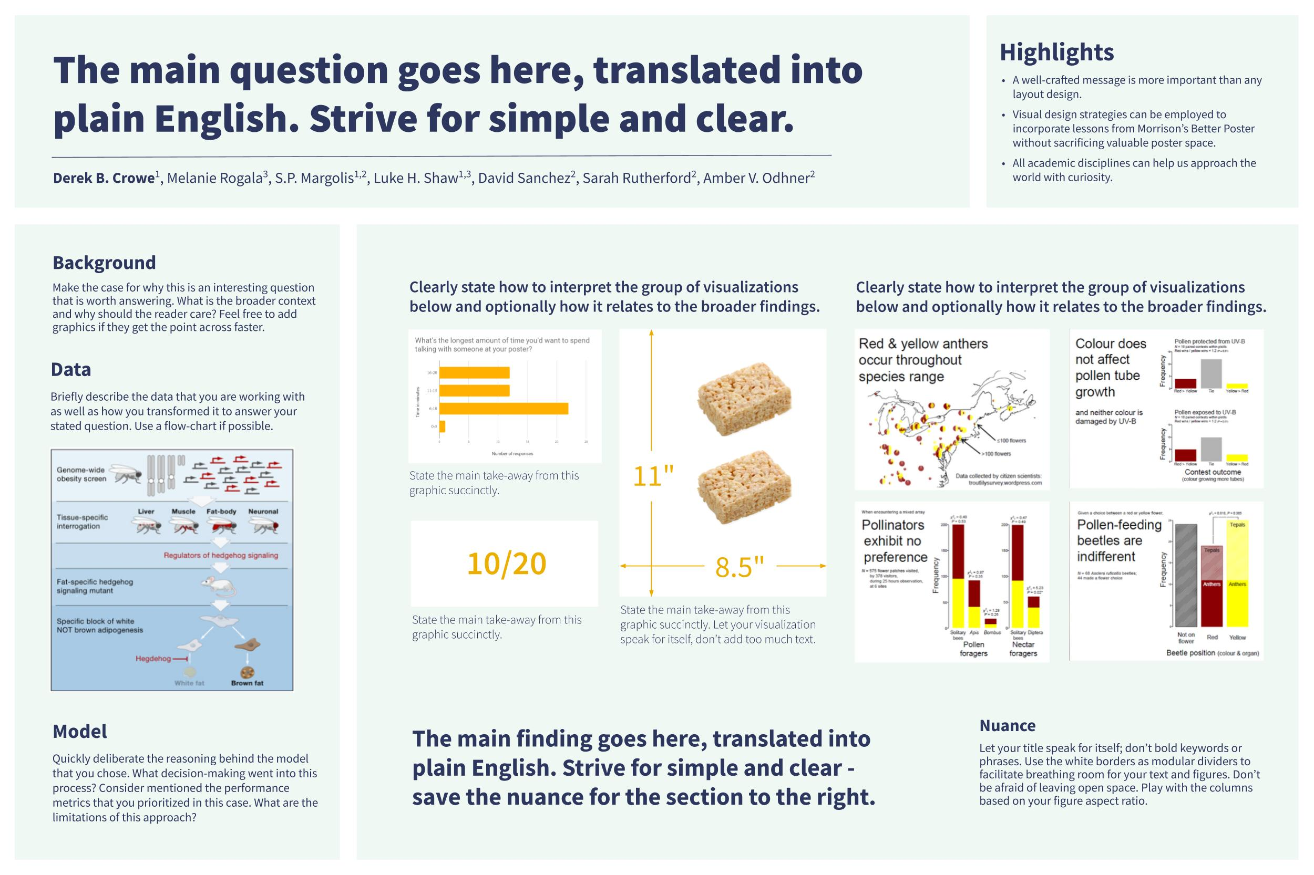
The Datafolio is a visual snapshot of a data project.
It’s designed to
quickly demonstrate your data experience
highlight your data storytelling skills
be accessible to non-technical audiences

Slide 2
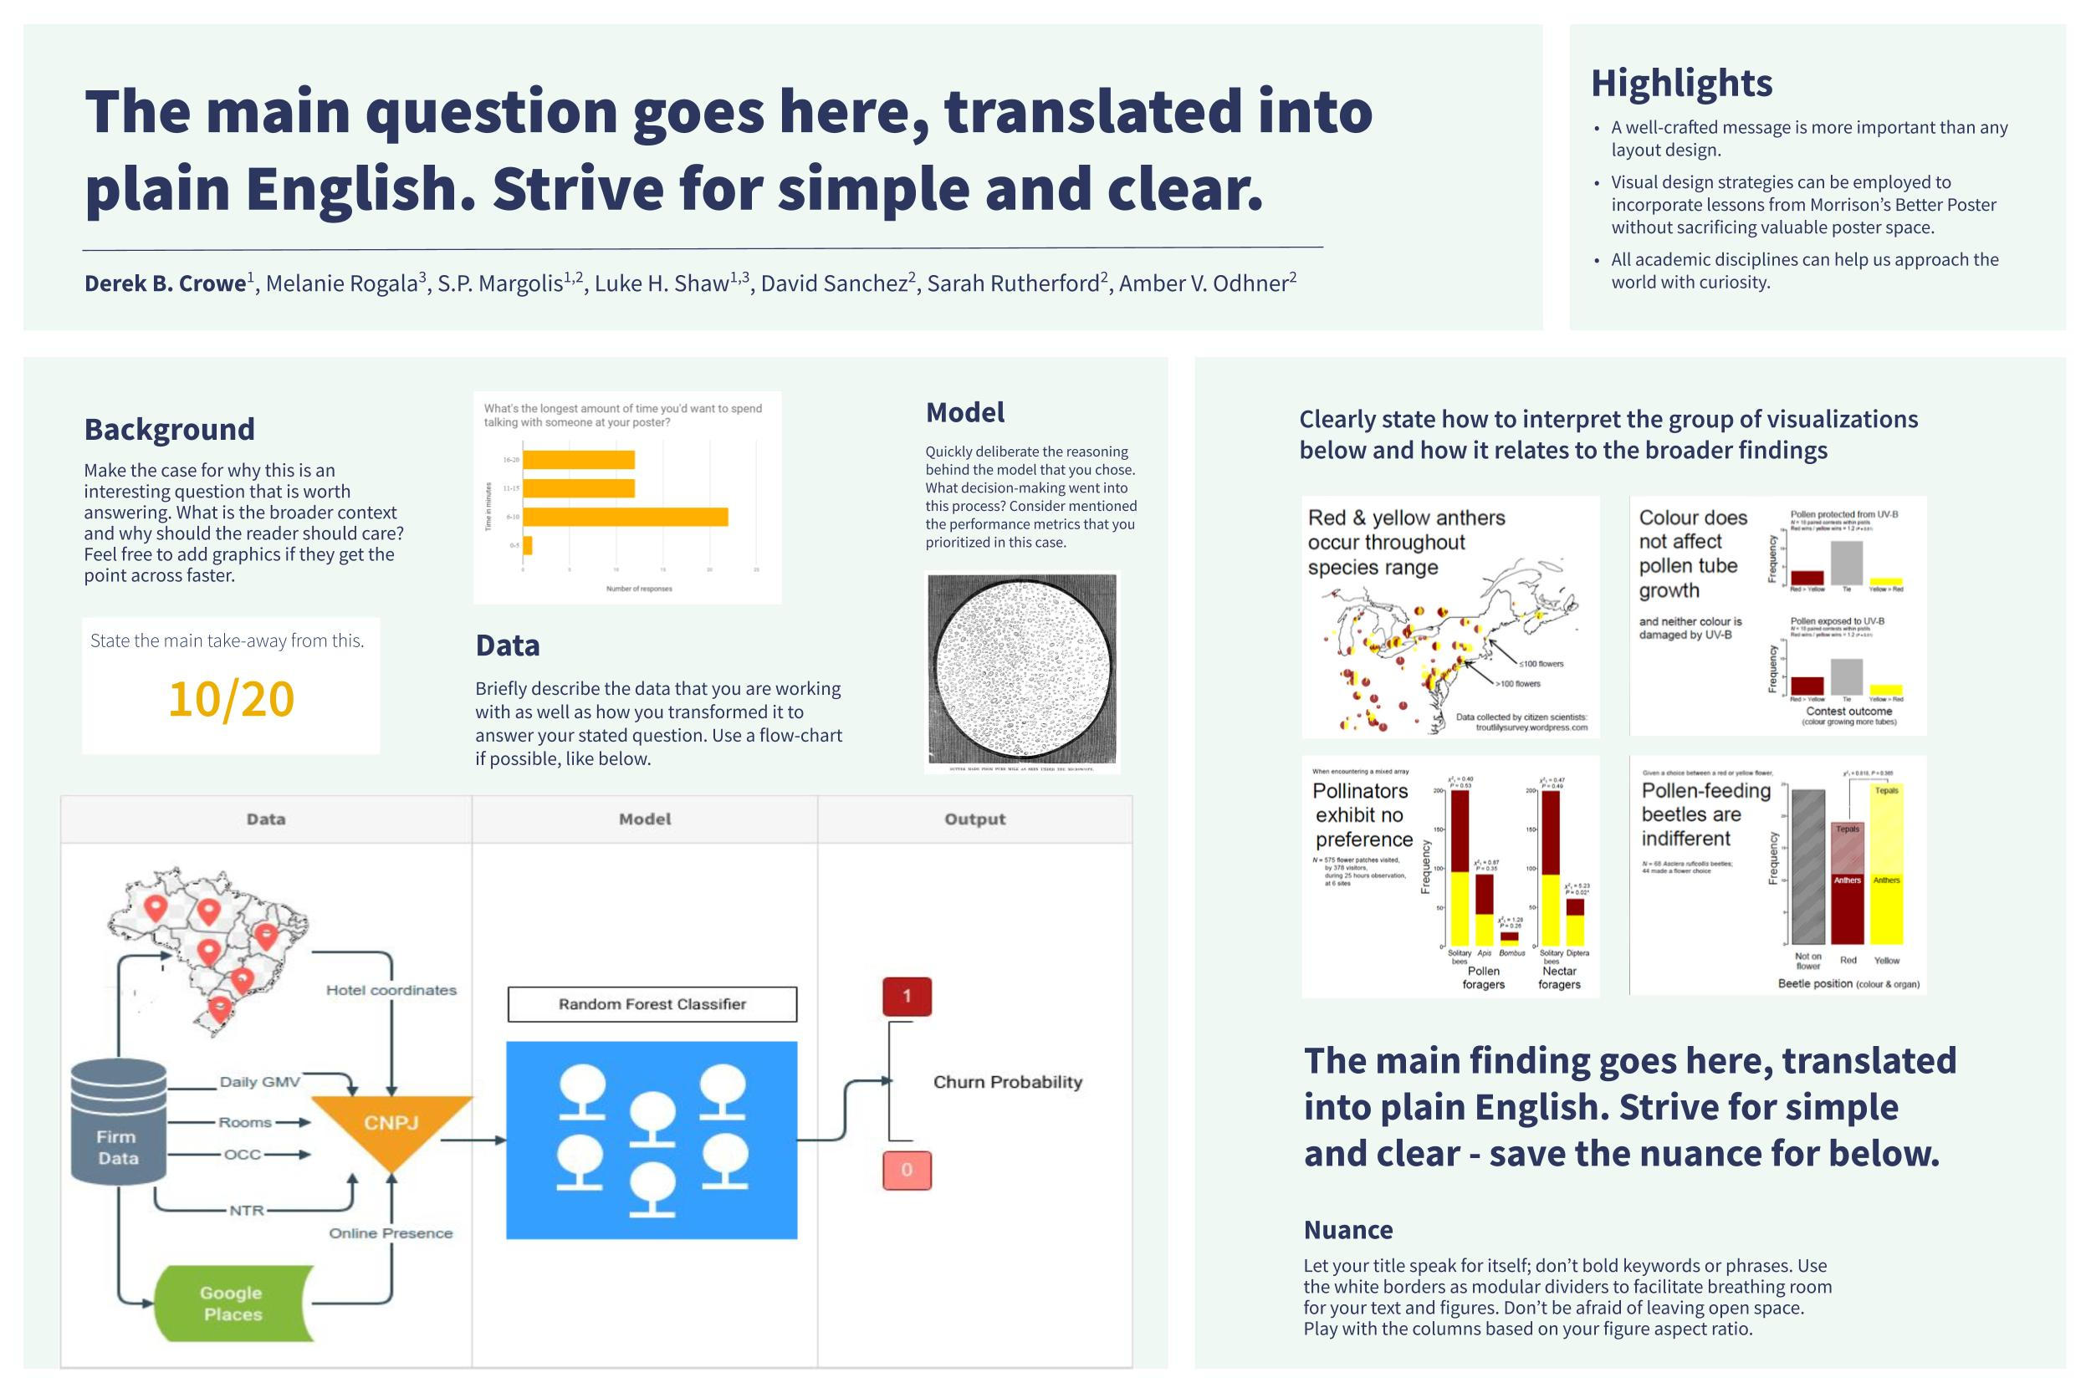
Data projects differ greatly and a one size fits all template cannot capture them all. Instead, we provide different starting points that reflect distinct types of projects.
Emphasis on EDA and results.
Emphasis on data and model.

Slide 3
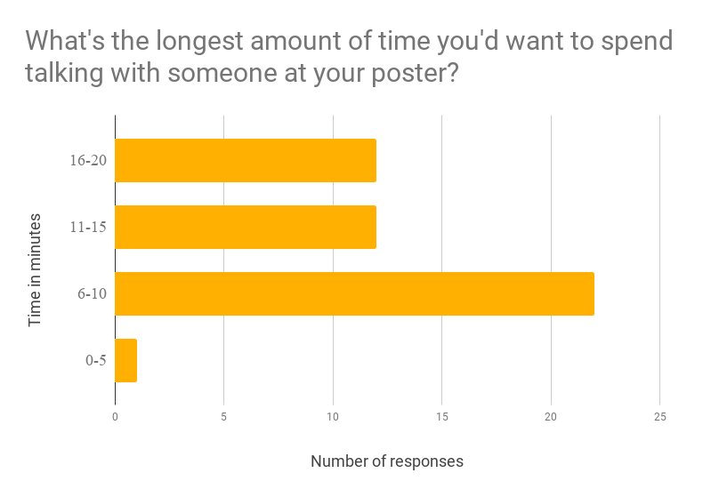
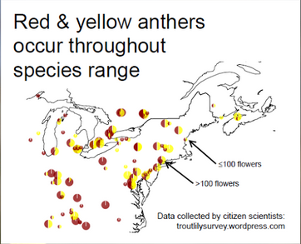
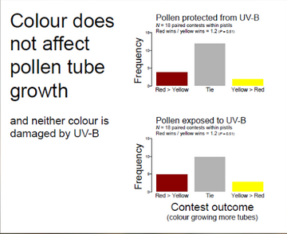
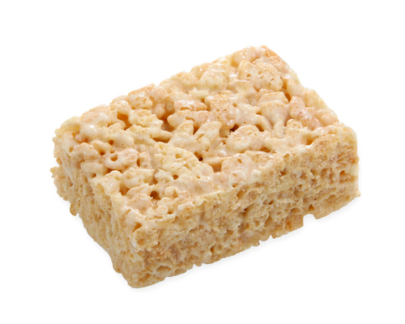
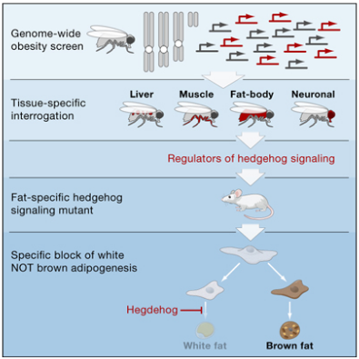
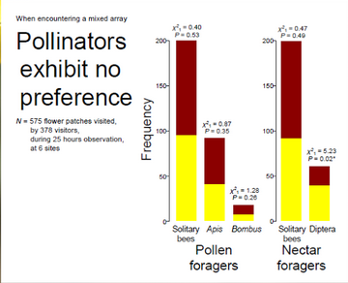
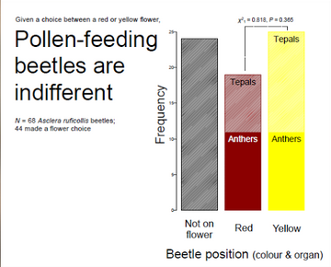
The main question goes here, translated into plain English. Strive for simple and clear.
Highlights
A well-crafted message is more important than any layout design.
Visual design strategies can be employed to incorporate lessons from Morrison’s Better Poster without sacrificing valuable poster space.
All academic disciplines can help us approach the world with curiosity.
Derek B. Crowe¹, Melanie Rogala³, S.P. Margolis^{1,2}, Luke H. Shaw^{1,3}, David Sanchez², Sarah Rutherford², Amber V. Odhner²
Background
Make the case for why this is an interesting question that is worth answering. What is the broader context and why should the reader care? Feel free to add graphics if they get the point across faster.
Clearly state how to interpret the group of visualizations below and optionally how it relates to the broader findings.
Clearly state how to interpret the group of visualizations below and optionally how it relates to the broader findings.
Data
Briefly describe the data that you are working with as well as how you transformed it to answer your stated question. Use a flow-chart if possible.
State the main take-away from this graphic succinctly.
11"
10/20
8.5"
State the main take-away from this graphic succinctly.
State the main take-away from this graphic succinctly. Let your visualization speak for itself, don’t add too much text.
Model
Quickly deliberate the reasoning behind the model that you chose. What decision-making went into this process? Consider mentioned the performance metrics that you prioritized in this case. What are the limitations of this approach?
The main finding goes here, translated into plain English. Strive for simple and clear - save the nuance for the section to the right.
Nuance
Let your title speak for itself; don’t bold keywords or phrases. Use the white borders as modular dividers to facilitate breathing room for your text and figures. Don’t be afraid of leaving open space. Play with the columns based on your figure aspect ratio.
Notes:
Notes:
In Powerpoint, click View > Guides
Keep text within gutter guides.
Author list: Don’t split names onto two lines (e.g., “Jimmy [break] Smith”). If that happens, use a new line, unless you need the space. Bold the first names of anybody who’s presenting in person.
Intro/methods/result: Do not drop below font size 28, but if you have extra space, jack up the font size until the space is full.
Do not use color in the sidebars except in graphs/figures. It’ll pull attention from the center and slow interpretation for passersby.

Slide 4
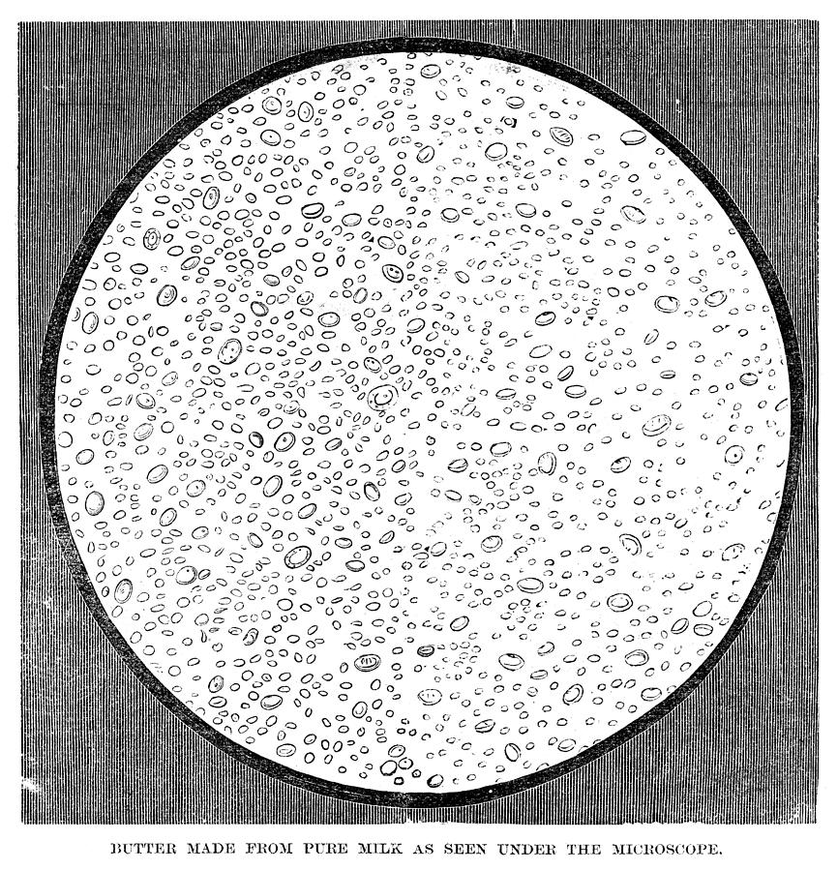
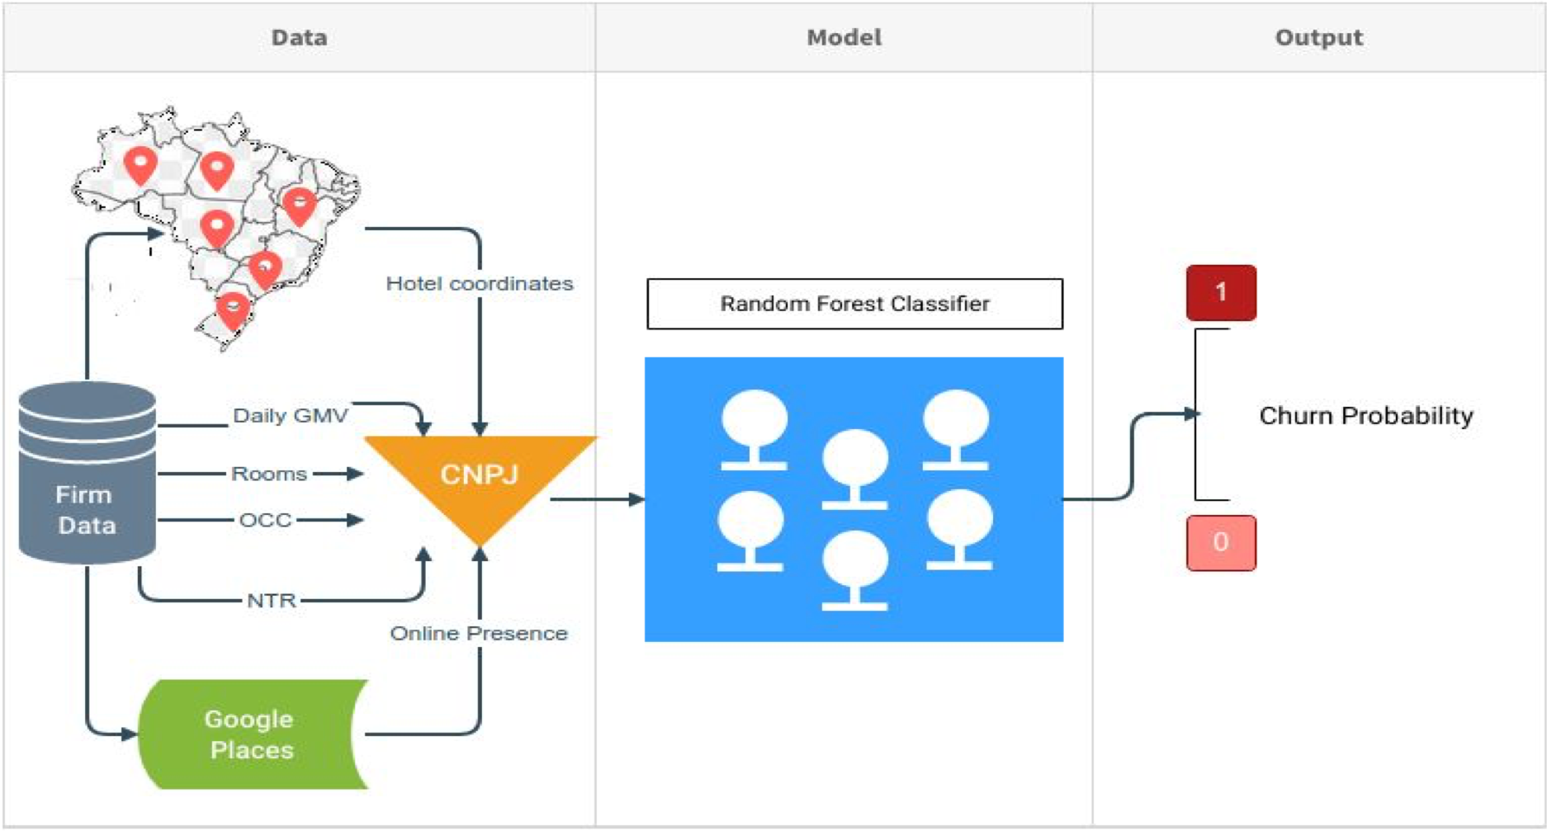
The main question goes here, translated into plain English. Strive for simple and clear.
Highlights
A well-crafted message is more important than any layout design.
Visual design strategies can be employed to incorporate lessons from Morrison’s Better Poster without sacrificing valuable poster space.
All academic disciplines can help us approach the world with curiosity.
Derek B. Crowe¹, Melanie Rogala³, S.P. Margolis^{1,2}, Luke H. Shaw^{1,3}, David Sanchez², Sarah Rutherford², Amber V. Odhner²
Background
Make the case for why this is an interesting question that is worth answering. What is the broader context and why should the reader should care? Feel free to add graphics if they get the point across faster.
Model
Quickly deliberate the reasoning behind the model that you chose. What decision-making went into this process? Consider mentioned the performance metrics that you prioritized in this case.
Clearly state how to interpret the group of visualizations below and how it relates to the broader findings
State the main take-away from this.
Data
Briefly describe the data that you are working with as well as how you transformed it to answer your stated question. Use a flow-chart if possible, like below.
10/20
The main finding goes here, translated into plain English. Strive for simple and clear - save the nuance for below.
Nuance
Let your title speak for itself; don’t bold keywords or phrases. Use the white borders as modular dividers to facilitate breathing room for your text and figures. Don’t be afraid of leaving open space. Play with the columns based on your figure aspect ratio.
Notes:
Notes:
In Powerpoint, click View > Guides
Keep text within gutter guides.
Author list: Don’t split names onto two lines (e.g., “Jimmy [break] Smith”). If that happens, use a new line, unless you need the space. Bold the first names of anybody who’s presenting in person.
Intro/methods/result: Do not drop below font size 28, but if you have extra space, jack up the font size until the space is full.
Do not use color in the sidebars except in graphs/figures. It’ll pull attention from the center and slow interpretation for passersby.

Slide 5
Datafolio F.A.Q.
What should I avoid?
Cutting and pasting text from your write-up won’t work. You need to rethink your messaging for this format.
You won’t be able to fit everything in. You need to be selective about what to include in the datafolio.
How do I distill my project into just one page?
Informative graphics, flowcharts, and visualizations are both more engaging and condensed than text-based descriptions of your methods and results.
How do I get started?
Skim through your project and find one narrative or story that you want to tell.
Outline the main points that you want to convey, and use them to motivate the design of the datafolio.

Slide 6
Gallery
Real datafolios designed using the starting points.

Slide 7
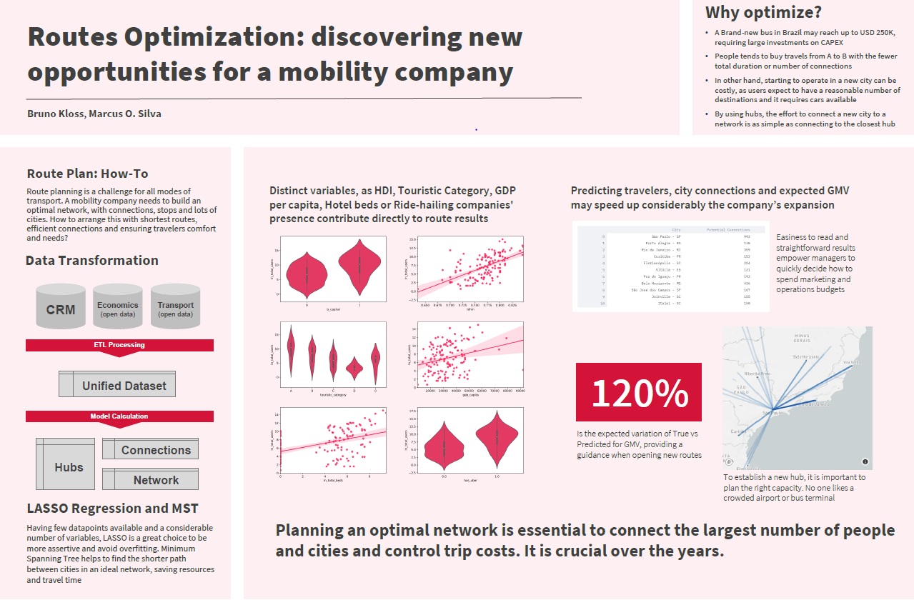
Add Visuals Charts, graphs, and maps are examples of great ways to tell your story

Slide 8
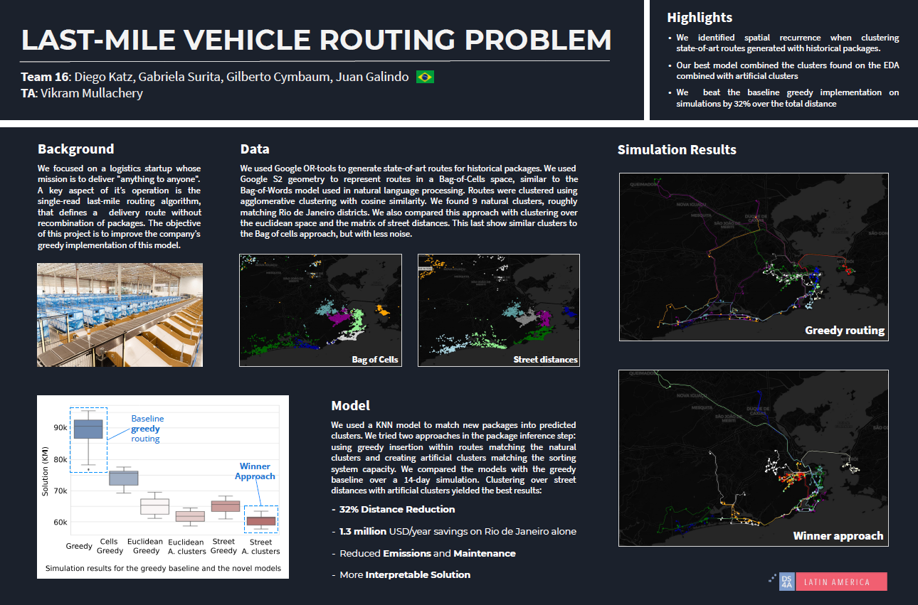
Tell a Story Focus on one narrative that you want to convey

Slide 9
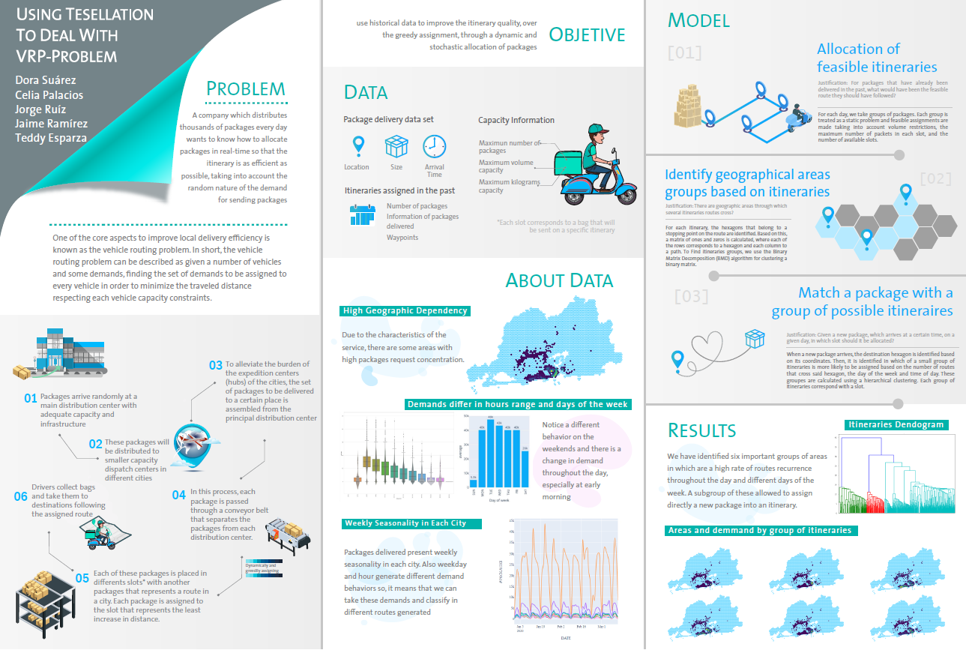
Make it Your Own Experiment with different layouts

Slide 10
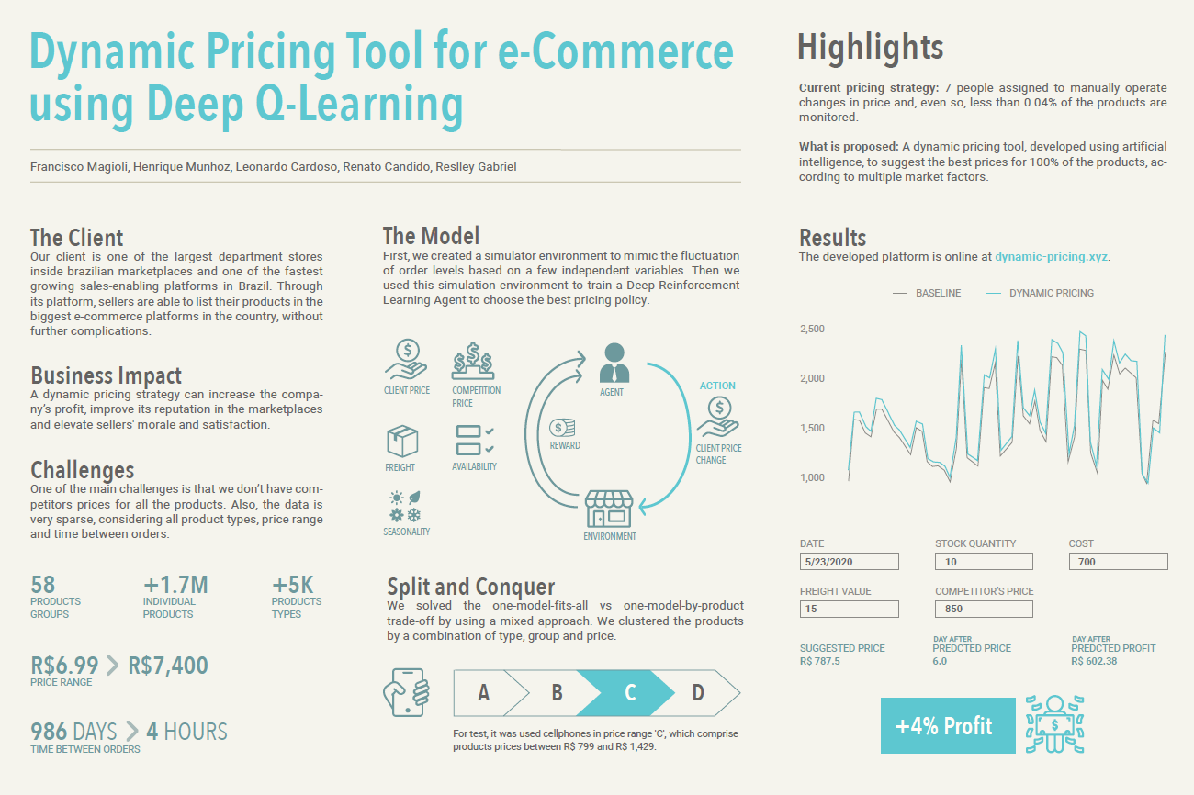
Keep it Simple Remember, you want a non-techinical audience to understand it as well

